Slide 1

Patients With Special Challenges
CHAPTER 37

Slide 2
National EMS Education Standard Competencies (1 of 5)
Special Patient Populations
Applies a fundamental knowledge of growth, development, and aging and assessment findings to provide basic emergency care and transportation for a patient with special needs.
Notes:
National EMS Education Standard Competencies
Special Patient Populations
Applies a fundamental knowledge of growth, development, and aging and assessment findings to provide basic emergency care and transportation for a patient with special needs.

Slide 3
National EMS Education Standard Competencies (2 of 5)
Patients With Special Challenges
Health care implications of
  Homelessness
  Poverty
  Bariatrics
  Technology dependent
Notes:
National EMS Education Standard Competencies
Patients With Special Challenges
Health care implications of
• Homelessness
• Poverty
• Bariatrics
• Technology dependent

Slide 4
National EMS Education Standard Competencies (3 of 5)
Patients With Special Challenges (cont’d)
Health care implications of (cont’d)
  Hospice/terminally ill
  Tracheostomy care/dysfunction
  Home care
  Sensory deficit/loss
  Developmental disability
Notes:
National EMS Education Standard Competencies
Health care implications of
• Hospice/terminally ill
• Tracheostomy care/dysfunction
• Home care
• Sensory deficit/loss
• Developmental disability

Slide 5
National EMS Education Standard Competencies (4 of 5)
Trauma
Applies fundamental knowledge to provide basic emergency care and transportation based on assessment findings for an acutely injured patient.
Notes:
National EMS Education Standard Competencies
Trauma
Applies fundamental knowledge to provide basic emergency care and transportation based on assessment findings for an acutely injured patient.

Slide 6
National EMS Education Standard Competencies (5 of 5)
Special Considerations in Trauma
Pathophysiology, assessment, and management of trauma in the
  Cognitively impaired patient
Notes:
National EMS Education Standard Competencies
Special Considerations in Trauma
• Pathophysiology, assessment, and management of trauma in the
• Cognitively impaired patient

Slide 7
Introduction (1 of 2)
Today, more people with chronic diseases live at home.
  Shorter hospitalization
  Improvements in medicine and technology
Patients with special challenges:
  Patients with diseases resulting in altered body function
  Patients with sensory deficits
  Geriatric patients with chronic diseases
Notes:
Lecture Outline
I. Introduction
A. Today, more people with chronic diseases live at home or outside of a hospital setting.
1. Children who were born prematurely and have associated respiratory problems
2. Infants or small children with congenital heart disease
3. Patients with neurologic disease
4. Patients with congenital or acquired diseases resulting in altered body function that requires medical assistance for breathing, eating, urination, or bowel function
5. Patients with sensory deficits such as hearing or visual impairments
6. Geriatric patients with chronic diseases requiring visitation from a home health care service

Slide 8
Introduction (2 of 2)
Some patients depend on mechanical ventilation, intravenous pumps, and other devices.
Do not be distracted by the equipment!
Focus on the patient.
Notes:
Lecture Outline
B. Some people living at home depend upon:
1. Mechanical ventilation
2. Intravenous pumps
3. Other devices
C. Do not allow yourself to be distracted by the noise and mechanics of the medical equipment—your focus needs to remain on the patient.
1. Focus on the XABCs.
2. If the emergency is the result of mechanical failure, use equipment on the ambulance or the family’s “go bag.”

Slide 9
Intellectual Disability (1 of 3)
Developmental disability
  Conditions that may impair development with physical ability, learning, language development, or behavioral coping skills.
Intellectual disability
  Subset of developmental disability
  Significant limitations in intellectual functioning and skills needed for daily living
Notes:
Lecture Outline
II. Intellectual Disability
A. Developmental disability
1. Refers to a group of conditions that may impair development in the areas of physical ability, learning, language development skills, or behavioral coping skills.
2. Intellectual disability is a subset of developmental disability, where patients have significant limitations in both intellectual functioning and skills needed for daily living.
a. Diagnosis is made before age 18 years.
b. Ranges from mild to profound.
c. Level of care and support varies.

Slide 10
Intellectual Disability (2 of 3)
Possible causes
  Genetic factors
  Congenital infections
  Malnutrition
  Environmental factors
  Fetal alcohol syndrome
  Traumatic brain injury
  Poisoning
Notes:
Lecture Outline
3. Possible causes
a. Genetic factors
b. Congenital infections
c. Complications at birth
d. Malnutrition
e. Environmental factors
f. Prenatal drug or alcohol use
g. Traumatic brain injury
h. Poisoning

Slide 11
Intellectual Disability (3 of 3)
Rely on patients and family members for information.
Patient may have difficulty adjusting to change or a break in routine.
Patients with intellectual disabilities are susceptible to the same diseases as other patients.
Notes:
Lecture Outline
4. Rely on patients and family members for information.
5. Patients with intellectual disabilities are susceptible to the same diseases as other patients.

Slide 12
Autism Spectrum Disorder (1 of 3)
Intellectual disability characterized deficits in social communication along with restrictive, repetitive patterns of behavior, interests, and activities.
Notes:
Lecture Outline
B. Autism Spectrum Disorder
1. Intellectual disability characterized by deficits in social communication and interactions along with restrictive, repetitive patterns of behavior, interests, and activities.

Slide 13
Autism Spectrum Disorder (2 of 3)
Often have abnormal sensory responses
  May not feel cold, heat, or pain as others do
  May respond to pain by laughing, humming, singing, or removing clothing
May have increased sensitivity to noise or physical stimulation
  Keep the environment calm and minimize stimulation.
Notes:
Lecture Outline
a. Often have abnormal sensory responses
i. May not feel cold, heat, or pain as others do.
ii. May respond to pain by laughing, humming, singing, or removing clothing.
b. May have increased sensitivity to noise or physical stimulation.
i. Keep the environment calm and minimize stimulation

Slide 14
Autism Spectrum Disorder (3 of 3)
Increased sensitivity to noise or physical stimulation (cont’d)
  Demonstration of examination techniques on a trusted individual may comfort the patient.
  Use short, direct and simple phrases when communicating.
  Allow extra time for the patient to process the communication if possible.
Notes:
Lecture Outline
ii. Three to four times more common in males than females and in those who have an older sibling with the condition.
iii. Demonstration of examination techniques on a trusted individual may comfort the patient.
iv. Use short, direct, and simple phrases when communicating, and allow extra time for the patient to process the communication if possible.

Slide 15
Down Syndrome (1 of 4)
A genetic chromosomal defect that can occur during fetal development
  Results in mild to severe intellectual impairment
Increased maternal age and family history are known risk factors.
Notes:
Lecture Outline
C. Down syndrome
1. Characterized by a genetic chromosomal defect that can occur during fetal development, resulting in mild to severe intellectual impairment
a. Known risk factors are increased maternal age and a family history are known risk factors for this condition.

Slide 16
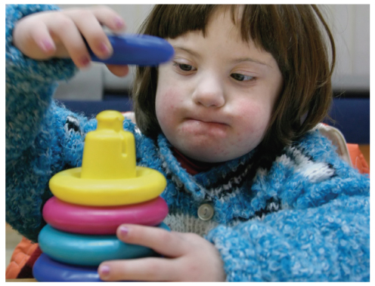
Down Syndrome (2 of 4)
Physical abnormalities
  Round head with flat occiput
  Enlarged, protruding tongue
  Slanted, wide-set eyes
FIGURE 37-1 A child with Down syndrome.
© PhotoCreate/Shutterstock.
Notes:
Lecture Outline
2. Physical abnormalities
a. Round head with a flat occiput
b. Enlarged, protruding tongue
c. Slanted, wide-set eyes and folded skin on either side of the nose, covering the inner corners of the eye
d. Short, wide hands
e. Small face and features

Slide 17
Down Syndrome (3 of 4)
Increased risk for medical complications
  Leukemia
  Congenital heart defects
  Intubation may be difficult due to large tongues and small oral and nasal cavities.
  Mask ventilation can be challenging.
  Jaw-thrust maneuver or a nasopharyngeal airway may be necessary.
Notes:
Lecture Outline
3. Increased risk for medical complications
a. Leukemia
b. Congenital heart defects
c. Sensory, endocrine, musculoskeletal, dental, gastrointestinal, and neurological complications.
4. Intubation may be difficult due to large tongues and small oral and nasal cavities.
5. Mask ventilation can be challenging—jaw-thrust maneuver or a nasopharyngeal airway may be necessary.

Slide 18
Down Syndrome (4 of 4)
Management of seizures is the same for any other patent.
The atlantoaxial joint is unstable in approximately 15% of patients with Down syndrome.
  Increased risk of complications when they experience trauma
Notes:
Lecture Outline
6. Management of seizures is the same as for any other patient with seizures
7. In approximately 15% of people with Down syndrome, the atlantoaxial joint, where the first two vertebrae meet, is unstable.
a. Increased risk of complications when they experience trauma

Slide 19
Patient Interaction
Approach in a calm, friendly manner.
Establish rapport.
Introduce your team members.
Explain what you are doing.
Move slowly but deliberately.
Stay at eye level with the patient.
Notes:
Lecture Outline
D. Patient interaction
1. Approach the patient in a calm, friendly manner, watching for signs of increased anxiety or fear.
2. Have the members of your team hold back slightly until you can establish a rapport with the patient.
3. Introduce the team members and explain what they are going to do.
4. Move slowly but deliberately, explaining beforehand what you are going to do.
a. Make sure you are at eye level with the patient.
5. Do your best to soothe the patient’s and discomfort as you work through your assessment and provide treatment.

Slide 20
Brain Injury
Patients with a prior brain injury may be difficult to treat.
Talk with patient and family.
  Establish what is considered normal for the patient.
Explain procedures and reassure patient.
Notes:
Lecture Outline
E. Brain injury
1. Patients with a prior brain injury may be difficult to assess and treat.
2. Take the time to speak with the patient and family to establish what is considered normal for the patient.
3. Treat the patient with respect, use his or her name, explain procedures, and reassure the patient throughout the process.

Slide 21
Visual Impairment (1 of 4)
Possible causes
  Congenital defect
  Disease
  Injury
  Degeneration of the eyeball optic nerve or nerve pathway
Notes:
Lecture Outline
III. Sensory Disabilities
A. Visual Impairment
1. Possible causes
a. Congenital defect
b. Disease
c. Injury
d. Degeneration of the eyeball optic nerve or nerve pathway

Slide 22
Visual Impairment (2 of 4)
Range in degree of visual impairment
  Some patients lose peripheral or central vision.
  Some can distinguish light from dark or shapes.
Visual impairments may be difficult to recognize.
Notes:
Lecture Outline
2. Degree of visual impairment may range from partial to total.
a. Some patients lose peripheral or central vision.
b. Some can distinguish light from dark or discern general shapes.
3. Visual impairments may be difficult to recognize.
a. Look for signs that the patient is visually impaired (glasses, cane, service animal).

Slide 23
Visual Impairment (3 of 4)
Patient interaction
  Make yourself known when you enter.
  Introduce yourself and your team.
  Retrieve any visual aids and give them to your patient.
  Patient may feel vulnerable and disoriented.
  Describe the situation and surroundings to the patient.
Notes:
Lecture Outline
4. Patient interaction
a. Make yourself known when you enter the room.
b. Introduce yourself and your team or have them introduce themselves so that the patient can identify their voices and locations.
c. Retrieve any visual aids and give them to your patient to make the interaction more comfortable.
d. A visually impaired patient may feel vulnerable, especially during the chaos of a crash scene.
e. The patient may have learned to use other senses such as hearing, touch, and smell to compensate for the loss of sight, and the sounds and smells of the scene may be disorienting.
f. Tell the patient what is happening, identify noises, and describe the situation and surroundings, especially if you must move the patient.

Slide 24
Visual Impairment (4 of 4)
Transport considerations
  Take cane or walker, if used.
  Make arrangements for care or accompaniment of service animal.
  Patients should be gently guided, never pulled or pushed.
  Communicate obstacles in advance.
Notes:
Lecture Outline
5. Transport considerations
a. Patient may use a cane or walker (be sure to take it with you).
b. A service animal can remain with the patient and will provide reassurance for the patient and prevent delays in transport; however, in some cases you may need to make arrangements for the care or accompaniment of the animal.
c. An ambulatory patient may be led by a light touch on the arm or elbow or the patient may rest his or her hand on your shoulder.
i. Ask patients which method they prefer to use.
ii. Patients should be gently guided but never pulled or pushed.
iii. Obstacles need to be communicated in advance.

Slide 25
Hearing Impairment (1 of 2)
Problems range from slight hearing loss to total deafness.
  Many older people have some hearing loss.
Sensorineural deafness is caused by nerve damage.
Conductive hearing loss is caused by faulty transmission of sound waves.
Notes:
Lecture Outline
B. Hearing Impairment
1. Impairment may range from a slight hearing loss to total deafness.
2. Most common forms of hearing loss
a. Sensorineural deafness (nerve damage)
b. Conductive hearing loss
i. Faulty transmission of sound waves

Slide 26
Hearing Impairment (2 of 2)
Clues that a person could be hearing impaired
  Presence of hearing aids
  Poor pronunciation of words
  Failure to respond to your presence or questions
Notes:
Lecture Outline
3. Clues that a person could be hearing impaired
a. Presence of hearing aids
b. Poor pronunciation of words
c. Failure to respond to your presence or questions

Slide 27
Communication With Hearing Impaired Patient (1 of 3)
Assist the patient with finding and inserting any hearing aids.
Face the patient while you communicate.
Do not exaggerate your lip movements or look away.
Position yourself approximately 18 inches directly in front of the patient.
Notes:
Lecture Outline
d. Communication
a. Assist the patient with finding and inserting any hearing aids.
b. Face the patient while you communicate.
c. Do not exaggerate your lip movements or look away.
d. Position yourself approximately 18 inches directly in front of the patient.

Slide 28
Communication With Hearing Impaired Patient (2 of 3)
Do not speak louder; try lowering the pitch of your voice.
American Sign Language may be useful.
Provide paper and a pencil.
Only one person ask questions.
“Reverse stethoscope”
Notes:
Lecture Outline
e. Do not speak louder, and try lowering the pitch of your voice.
f. American sign language
g. Provide paper and a pencil
h. Only one person should ask questions to avoid confusing the patient.
i. “Reverse stethoscope”

Slide 29
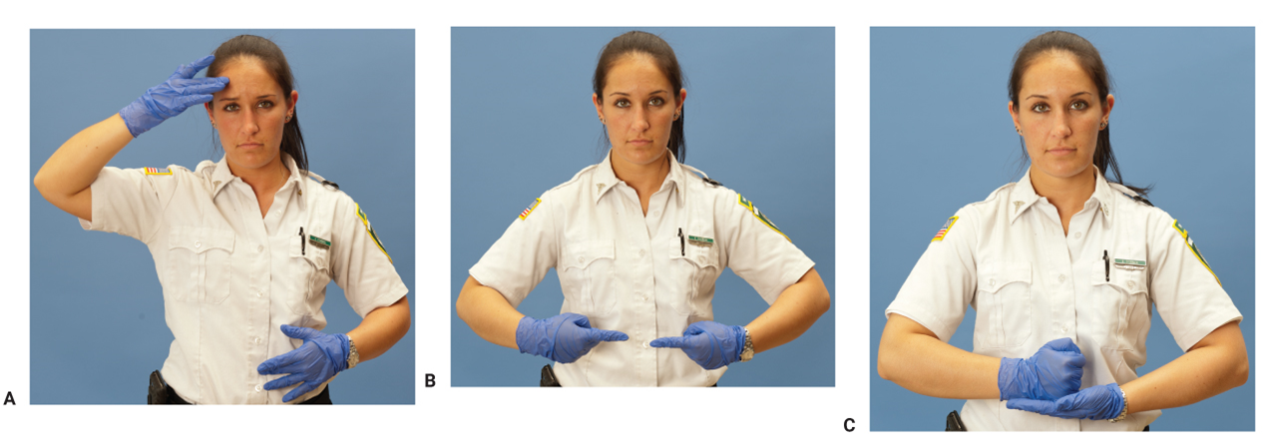
Communication With Hearing Impaired Patient (3 of 3)
FIGURE 37-3 Consider learning common terms in American Sign Language related to illness and injury. A. Sick. B. Hurt. C. Help
A, B, C: © Jones & Bartlett Learning. Photographed by Glen E. Ellman.
Notes:
The figure on this slide shows terms in American Sign Language related to illness and injury: sick (A), hurt (B), and help (C).

Slide 30
Hearing Aids (1 of 2)
Hearing aids make sound louder.
May be external or internal
Several types are available.
  Behind-the-ear, conventional body, in-the-canal, in-the-ear
Device should fit snugly.
  If whistling occurs, it may not be in far enough.
Notes:
Lecture Outline
5. Device that makes sound louder
a. Behind-the-ear type
b. Conventional body type
c. In-the-canal and completely in-the-canal type
d. In-the-ear type
e. Implantable options are also available.
6. The device should fit snugly.
7. If whistling occurs, the hearing aid may not be in far enough.

Slide 31
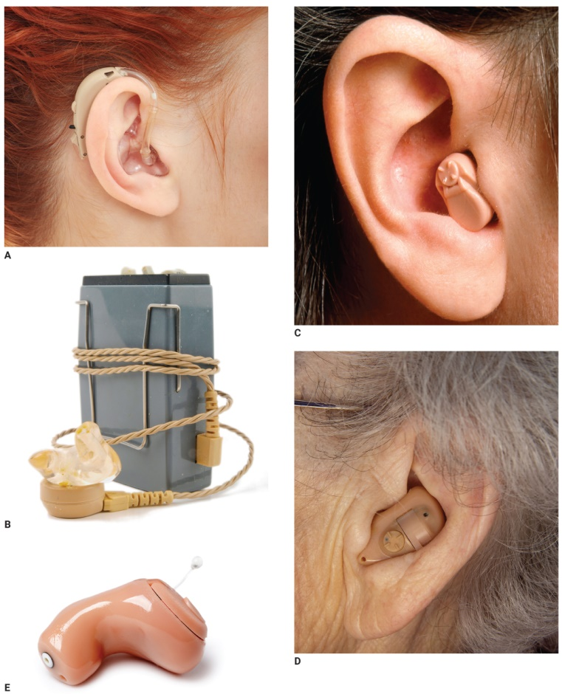
Hearing Aids (2 of 2)
FIGURE 37-4 Different types of hearing aids. A. Behind-the-ear. B. Conventional body. C. In-the-canal. D. In-the-ear.
E. Completely in-the-canal.
A: © Piotr Marcinski/Shutterstock; B: © Stine Lise Nielsen/Shutterstock; C: © Steve Hamblin/Alamy;
D: © Terry Smith Images/Alamy; E: © Jiri Hera/Shutterstock.
Notes:
The figure on this slide shows different types of hearing aids: behind-the-ear (A), conventional body (B), in-the-canal (C), in-the-ear (D), and completely in-the-canal (E).

Slide 32
Cerebral Palsy (1 of 4)
Group of disorders characterized by poorly controlled body movement
Possible causes
  Damage to the developing brain in utero
  Oxygen deprivation at birth
  Traumatic brain injury
  Infection such as meningitis during early childhood
Notes:
Lecture Outline
IV. Physical Disabilities
A. Cerebral palsy
1. Group of disorders characterized by poorly controlled body movement
a. Result of damage to the developing fetal brain while in utero
b. Oxygen deprivation at birth
c. Traumatic brain injury at birth
d. Infection such as meningitis during early childhood

Slide 33
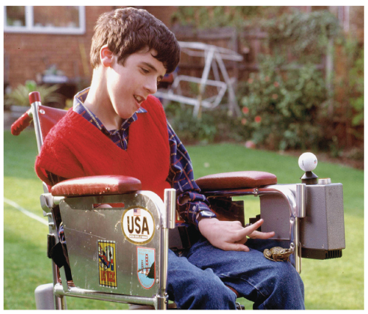
Cerebral Palsy (2 of 4)
Symptoms
  Poor posture
  Uncontrolled, spastic movements
  Visual and hearing impairments
  Difficulty communicating
  Unsteady gait
FIGURE 37-5 A person with cerebral palsy.
© Sally and Richard Greenhill/Alamy.
Notes:
Lecture Outline
2. Range of mild to severe symptoms
a. Poor posture
b. Uncontrolled, spastic movements of the limbs
c. Visual and hearing impairments
d. Difficulty communicating
e. Epilepsy (seizures)
f. Intellectual disabilities
g. Unsteady gait (ataxia), which may necessitate wheelchair or walker

Slide 34
Cerebral Palsy (3 of 4)
Considerations
  Observe airway closely and suction as needed.
  Do not assume intellectual disability.
  Underdeveloped limbs are prone to injury.
  Ataxic or unsteady gait makes patients prone to falls.
  Patient may have special pillow or chair.
Notes:
Lecture Outline
3. Important considerations
a. Observe airway closely
b. Do not assume that patients have an intellectual disability.
c. Limbs are often underdeveloped and are prone to injury.
d. Patients who have the ability to walk may have an ataxic or unsteady gait and are prone to falls.

Slide 35
Cerebral Palsy (4 of 4)
Considerations (cont’d)
  Pad the patient to ensure comfort.
  Never force extremities into position.
  Whenever possible, take walkers or wheelchairs along during transport.
  Be prepared for a seizure, and keep suctioning available.
Notes:
Lecture Outline
e. Pad the patient to ensure his or her comfort.
f. Never force a patient’s extremities into any position.
g. Whenever possible, take walkers or wheelchairs along during transport.
h. Be prepared for a seizure, and keep suctioning available.

Slide 36
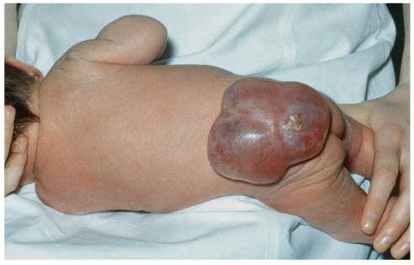
Spina Bifida (1 of 2)
Birth defect caused by incomplete closure of spinal column
  Spinal cord is exposed.
Opening can be closed surgically, but often leaves spinal damage.
FIGURE 37-6 Spina bifida is one of the most common
disabling birth defects in the United States.
© Biophoto Associates/Photo Researchers, Inc.
Notes:
Lecture Outline
B. Spina bifida
1. Birth defect caused by incomplete closure of spinal column during embryonic or fetal development
2. Spinal cord is exposed.
3. Opening can be closed surgically, but often leaves spinal and neurologic damage.

Slide 37
Spina Bifida (2 of 2)
Associated conditions
  Hydrocephalus (requires shunt)
  Partial or full paralysis of the lower extremities
  Loss of bowel and bladder control
  Extreme latex allergy
Notes:
Lecture Outline
4. Associated conditions
a. Hydrocephalus
b. Partial or full paralysis of the lower extremities
c. Loss of bowel and bladder control
d. Extreme latex allergy
5. Ask patients or caregivers how to best move them before you transport them.

Slide 38
Paralysis (1 of 2)
Inability to voluntarily move body parts
Causes: stroke, trauma, birth defects
May have normal sensation or hyperesthesia
May cause communication challenges
Diaphragm may not function correctly (requires ventilator).
Notes:
Lecture Outline
C. Paralysis
1. Inability to voluntarily move one or more body parts
2. Possible causes include stroke, trauma, or birth defects
3. Patient may have normal sensation or hyperesthesia (increased sensitivity).
4. Facial paralysis may also cause communication challenges
5. Diaphragm may not function correctly, requiring the use of a ventilator.

Slide 39
Paralysis (2 of 2)
Specialized equipment
  Urinary catheters
  Tracheostomy tubes
  Colostomy bags
  Feeding tubes
Difficulty swallowing may require suctioning.
Ask patients how it is best to move them before you transport them.
Notes:
Lecture Outline
6. Patients may have specialized equipment
a. Urinary catheters
b. Tracheotomy tubes
c. Colostomy bags
d. Feeding tubes
Patients may have difficulty swallowing, creating the need for suctioning.
8. Ask patients or caregivers how to best move them before you transport them.

Slide 40
Bariatric Patients (1 of 2)
Obesity: person has excessive body fat.
  Obese: 30% over ideal body weight
  Severe obesity: 2–3 times over the ideal weight
Imbalance between calories consumed and calories used
May be attributed to low metabolic rate or genetic predisposition
Notes:
Lecture Outline
V. Bariatric Patients
A. Obesity is a condition in which a person has an excessive amount of body fat.
1. The result of an imbalance between calories consumed and calories used
2. Causes of obesity are not fully understood.
3. May be attributed to a low metabolic rate or genetic predisposition
B. Severe or morbid obesity
1. Term obese used when someone is 30% or more over his or her ideal body weight
2. Severe obesity is when a person is 2–3 times over the ideal weight.

Slide 41
Bariatric Patients (2 of 2)
Quality of life is negatively affected.
Associated health problems
  Mobility difficulties
  Diabetes
  Hypertension
  Heart disease
  Stroke
Notes:
Lecture Outline
3. Quality of life may be negatively affected.
4. Associated health problems
a. Mobility difficulties
b. Diabetes
c. Hypertension
d. Heart disease
e. Stroke

Slide 42
Interaction with Patients with Obesity (1 of 4)
Patient may be embarrassed.
Plan early for extra help or equipment.
  Find easiest and safest exit.
  Do not risk dropping the patient or injuring a team member.
Notes:
Lecture Outline
C. Interaction with patients with obesity
1. Patients may be embarrassed by their condition.
2. If transport is necessary, plan early for extra help and/or specialized equipment.
a. Send a member of your team to find the easiest and safest exit.
b. Do not risk dropping the patient or injuring a team member by trying to lift too much weight.

Slide 43
Interaction with Patients with Obesity (2 of 4)
Treat the patient with dignity and respect.
Ask your patient how it is best to move him or her before attempting to do so.
Avoid trying to lift the patient by one limb, which would risk injury to overtaxed joints.
Coordinate and communicate all moves to all team members prior to starting to lift.
Notes:
Lecture Outline
3. Treat the patient with dignity and respect.
4. Ask your patient how it is best to move him or her before attempting to do so.
5. Avoid lifting the patient by only one limb, which would risk injury to overtaxed joints.
6. Coordinate and communicate all moves to all team members prior to starting to lift.

Slide 44
Interaction with Patients with Obesity (3 of 4)
If the move becomes uncontrolled at any point, stop, reposition, and resume.
Look for pinch or pressure points from equipment (deep venous thrombosis).
Large patients may have difficulty breathing if you lay them in a supine position.
Notes:
Lecture Outline
7. To prevent significant soft tissue injury or deep venous thrombosis, look for pinch or pressure points from equipment.
8. Become familiar with types of specialized equipment and resources available.
9. Large patients may have difficulty breathing if placed in a supine position.

Slide 45
Interaction with Patients with Obesity (4 of 4)
Specialized equipment is available.
  Become familiar with the resources available in your area.
Plan egress routes.
Notify the receiving facility early.
Notes:
Lecture Outline
10. Plan egress routes to accommodate large patients, equipment, and the lifting crew members.
11. Notify the receiving facility early.

Slide 46
Tracheostomy Tubes (1 of 5)
Tracheal stoma provides a path between the neck and the trachea.
  Kept open by plastic tracheostomy tube
  Tubes bypass nose and mouth
Temporary or permanent
For patients who depend on home automatic ventilators and have chronic pulmonary illness
Notes:
Lecture Outline
VI. Patients With Medical Technology Assistance
A. Tracheostomy tubes
1. Tracheal stoma provides a path between the surface of the neck and the trachea
2. Can be temporary or permanent
3. For patients who:
a. Depend on home automatic ventilators
b. Require frequent suctioning
c. Have chronic pulmonary medical conditions
4. Because it is foreign to the respiratory tract, the body reacts by building up secretions in or around the tube.

Slide 47
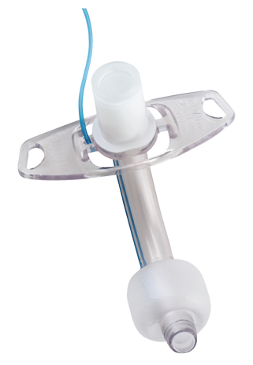
Tracheostomy Tubes (2 of 5)
Tubes are prone to obstruction by mucus or foreign bodies
  Emergency event
FIGURE 37-7 Some patients require a tracheostomy tube to breathe.
Portex® Blue Line® Ultra Tracheostomy courtesy of Smiths Medical.
Notes:
Lecture Outline
5. Tubes are prone to becoming obstructed by mucous plugs or foreign bodies.
a. The DOPE mnemonic is helpful

Slide 48
Tracheostomy Tubes (3 of 5)
DOPE mnemonic helps recognize causes of obstruction.
  Displacement, dislodged, or damaged tube
  Obstruction of the tube
  Pneumothorax
  Equipment failure
Notes:
Lecture Outline
a. DOPE mnemonic helps to recognize cause of obstruction
i. Displacement, dislodged, or damaged tube
ii. Obstruction of the tube (secretions, blood, mucus, vomitus)
iii. Pneumothorax
iv. Equipment failure (kinked tubing, ventilator malfunction, empty oxygen supply)

Slide 49
Tracheostomy Tubes (4 of 5)
Common problems
  Bleeding or air leaking around the tube
  Tube can become loose or dislodged.
  Opening around the tube may become infected.
Notes:
Lecture Outline
7. Common problems
a. Bleeding or air leaking around the tube
b. Tube can become loose or dislodged
c. Infection around the opening of the tube

Slide 50
Tracheostomy Tubes (5 of 5)
Management
  Maintain an open airway.
  Suction tube if necessary to clear a mucus plug.
  Maintain the patient in a position of comfort.
  Administer supplemental oxygen.
  Provide transport to the hospital.
Notes:
Lecture Outline
8. Management
a. Suction the patient in a position of comfort.
i. Insert the suction catheter no more than 1–2 inches.
ii. Do not suction for more than 10 seconds.
iii. Do not force the suction catheter into the cannula.
iv. Oxygenate before and after the procedure.
v. Call for ALS backup.

Slide 51
Home Oxygen (1 of 3)
Two types of oxygen delivery devices
  Oxygen from a gas cylinder
  Oxygen concentrator
Compressed oxygen cylinders
  Do not require oxygen or complex machinery
  Heavy, bulky, and can be difficult to transport
  Will run out of gas
  Patients coordinate pickup and delivery of cylinders.
Notes:
Lecture Outline
B. Home Oxygen
1. Two types of oxygen delivery devices
a. Oxygen from a gas cylinder
b. Oxygen concentrator
2. Compressed oxygen cylinders
a. Do not require electricity or complex machinery
b. Liter flow is limited only by the regulator and amount of gas in the cylinder.
c. Heavy, bulky, and can be difficult to transport
d. It will eventually run out of gas
e. Patients need to coordinate pickup and delivery of cylinders

Slide 52
Home Oxygen (2 of 3)
Home oxygen concentrator
  Takes ambient air and scrubs out the nitrogen
  Can provide an unlimited supply of oxygen
  Requires a reliable source of electricity
  Patient must have a backup compressed gas cylinder in case of power failure.
Notes:
Lecture Outline
3. Home oxygen concentrator
a. Takes ambient air and scrubs the nitrogen from the atmospheric air, leaving behind almost 100% oxygen.
b. Can provide an unlimited supply of oxygen as long as it is functioning and has a reliable source of electricity.
c. Usually able to supply 1 to 3 L/min
d. The patient must have a backup compressed gas cylinder in case of power failure.

Slide 53
Home Oxygen (3 of 3)
Ask the patient:
  Why they are on home oxygen
  How long they have been on home oxygen
  Baseline home oxygen requirement
  Baseline oxygen saturation
Notes:
Lecture Outline
4. Ask patient on home oxygen:
a. Why they are on home oxygen
b. How long they have been on home oxygen
c. What is their baseline home oxygen requirement
d. What the patient’s baseline oxygen saturation is

Slide 54
Mechanical Ventilators (1 of 3)
Used when patients cannot breathe without assistance
Possible causes
  Congenital defect
  Chronic lung disease
  Traumatic brain injury
  Muscular dystrophy
Notes:
Lecture Outline
C. Mechanical ventilators
1. Used when patients cannot breathe without assistance
2. Possible causes
a. Congenital defect
b. Chronic lung disease
c. Traumatic brain injury
d. Muscular dystrophy
e. Disease process that weakens the ability to breathe and requires a permanent tracheostomy and mechanical ventilator

Slide 55
Mechanical Ventilators (2 of 3)
If ventilator malfunctions:
  Remove patient from ventilator.
  Apply a tracheostomy collar.
    Designed to cover the tracheostomy hole
    May not be available in prehospital setting
  Can improvise by placing a face mask over the stoma
Notes:
Lecture Outline
3. If the ventilator malfunctions:
a. Remove the patient from the ventilator.
b. Apply a tracheostomy collar.
c. Can use a face mask over the stoma if you do not have a tracheostomy collar
4. Patients requiring assisted ventilation throughout transport.

Slide 56
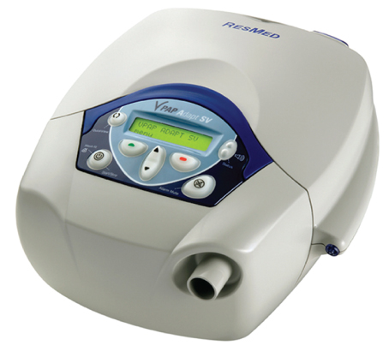
Mechanical Ventilators (3 of 3)
Caregivers will know how the equipment works.
FIGURE 37-10 A home ventilator.
© ResMed 2010. Used with permission.
Notes:
Lecture Outline
5. The patient’s caregivers will know how the mechanical ventilator works.

Slide 57
Apnea Monitors (1 of 2)
Used for infants who:
  Are premature and have severe gastroesophageal reflux
  Have family history of SIDS
  Experienced a life-threatening event
Notes:
Lecture Outline
C. Apnea monitors
1. Used for infants who:
a. Are premature
b. Have severe gastroesophageal reflux that causes choking episodes
c. Have a family history of sudden infant death syndrome
d. Have experienced an apparent life-threatening event

Slide 58
Apnea Monitors (2 of 2)
Used 2 weeks to 2 months after birth to monitor the respiratory system
Sounds an alarm if the infant experiences bradycardia or apnea
Attached with electrodes or belt around the infant’s chest or stomach
Provides a pulse oximetry reading
Notes:
Lecture Outline
2. Used for 2 weeks to 2 months after birth to monitor the respiratory system
3. Monitor sounds an alarm if the infant experiences bradycardia or apnea.
4. Attached with electrodes or belt around the infant’s chest or stomach
5. Provides a pulse oximetry reading that will assist you in assessing the patient’s respiratory status
6. If possible, bring the apnea monitor to the receiving hospital with the patient.

Slide 59
Internal Cardiac Pacemakers
Implanted under skin to regulate heart rate
  On nondominant side of the patient’s chest
May include automated implanted defibrillator
Never place defibrillator paddles or pacing patches directly over the implanted device.
Gather information about the type of cardiac pacemaker when obtaining history.
Notes:
Lecture Outline
E. Internal cardiac pacemakers
1. Device implanted under the patient’s skin to regulate the heart rate
2. Pacemaker may also include an automated implanted cardioverter defibrillator to monitor heart rhythm.
3. Never place defibrillator paddles or pacing patches directly over the implanted device.
4. Gather information about the cardiac pacemaker while you obtain the patient’s history.
a. Some patients will have a pacemaker identification card in their wallets containing information about the device.

Slide 60
Left Ventricular Assist Devices
Takes over the function of either one or both heart ventricles
Typically used as a bridge to heart transplantation
May be difficult to palpate a pulse
Provide support measures and basic care.
Use the caregiver as a resource.
Be prepared to provide CPR.
Notes:
Lecture Outline
F. Left ventricular assist devices
1. Medical device that takes over the function of one or both heart ventricles
2. Typically used as a bridge to heart transplantation while a donor heart is being located, or may be a permanent solution for patients who do not qualify for a transplant.
3. A left ventricular assist device (LVAD) is most common and all VADs are more common in adults.
4. May be difficult to palpate a pulse in patients who use an LVAD.
a. Assess perfusion by noting the level of consciousness, skin color, temperature, moisture, and blood pressure.
5. Risk factors associated with a VAD
a. Excessive bleeding following surgery
b. Infection
c. Blood clots
d. Acute heart failure
6. If you encounter a patient with a VAD, call the number of the patient’s support team, contact medical control, or follow protocols.
7. If the device’s alarm is sounding, check all connections, and be sure that the batteries are fully charged.
8. Notify ALS.

Slide 61
External Defibrillator Vest
Vest with built-in monitoring electrodes and defibrillation pads
  Worn by the patient under his or her clothing
Attached to a monitor that provides alerts and delivers a shock
If patient is in cardiac arrest, vest should remain in place while you perform CPR.
Notes:
Lecture Outline
G. External defibrillator vest
1. A vest with built-in monitoring electrodes and defibrillation pads, which is worn by the patient under his or her clothing
2. Attached to a monitor that provides alerts and voice prompts when it recognizes a dangerous rhythm and before it delivers a shock
3. If the patient is in cardiac arrest, the vest should remain in place while you perform CPR unless it interferes with compressions.
4. Any patient who is wearing a device that has already delivered a shock should be transported to the hospital for further evaluation.

Slide 62
Central Venous Catheter (1 of 3)
Catheter with its tip placed in vena cava to provide venous access
Used for many types of home care patients
Common locations
  Chest
  Upper arm
  Subclavicular area
Notes:
Lecture Outline
H. Central venous catheter
1. A catheter that has its tip placed in the vena cava to provide venous access
2. Used for many types of home care patients receiving:
a. Chemotherapy
b. Long-term antibiotic drug therapy or pain management
c. Total parenteral nutrition (TPN)
d. Hemodialysis
3. Often located in the chest, upper arm, or subclavicular area

Slide 63
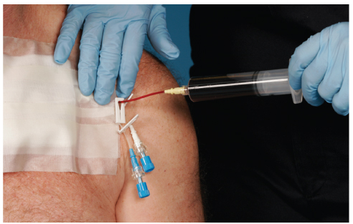
Central Venous Catheter (2 of 3)
FIGURE 37-13 Patients who require frequent intravenous
medications may have a central line in place.
© Jones & Bartlett Learning. Courtesy of MIEMSS.
Notes:
The figure on this slide shows a central venous catheter.

Slide 64
Central Venous Catheter (3 of 3)
Common problems
  Broken lines
  Infections around the lines
  Clotted lines
  Bleeding around the line or from the tubing attached to the line
Notes:
Lecture Outline
4. Common problems
a. Broken lines
b. Infections around the lines
c. Clotted lines
d. Bleeding around the line or from the tubing attached to the line

Slide 65
Gastrostomy Tubes (1 of 4)
Placed into the stomach for patients who cannot ingest fluids, food, or medication by mouth
  May be inserted through the nose or mouth into the stomach
  May be placed surgically directly into the stomach through the abdominal wall
Notes:
Lecture Outline
I. Gastrostomy tubes
1. Sometimes referred to as gastric tubes or G-tubes
2. Placed into the stomach for patients who cannot ingest fluids, food, or medication by mouth
a. May be inserted through the nose or mouth into the stomach (using a nasogastric or orogastric tube)
b. May be placed surgically directly into the stomach through the abdominal wall

Slide 66
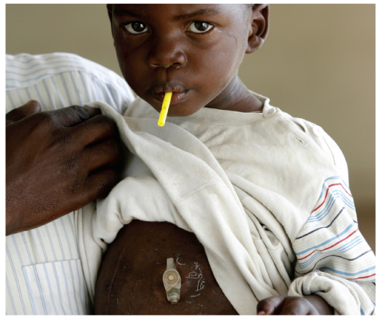
Gastrostomy Tubes (2 of 4)
FIGURE 37-14 Gastric tubes may be placed through the
skin into the stomach for children or adults who cannot be
fed by mouth.
© DELOCHE/age fotostock.
Notes:
The figure on this slide shows a gastrostomy tube in a child.

Slide 67
Gastrostomy Tubes (3 of 4)
May become dislodged
  Immediately stop the flow of any fluids.
Assess for signs or symptoms of bleeding into the stomach.
  Vague abdominal discomfort
  Nausea
  Vomiting (especially “coffee ground” emesis)
  Blood in emesis
Notes:
Lecture Outline
3. May become dislodged during the patient’s normal daily activity
a. Immediately stop the flow of any fluids.
b. Assess for signs or symptoms of bleeding into the stomach.
i. Vague abdominal discomfort
ii. Nausea
iii. Vomiting (especially “coffee ground” emesis)
iv. Blood in emesis

Slide 68
Gastrostomy Tubes (4 of 4)
Increased risk of aspiration
  Always have suction readily available.
  Patients with difficulty breathing should be transported while sitting or lying on their right side with head elevated 30°.
Continue tube feeding unless the tube is dysfunctional, dislodged, or partially dislodged.
Notes:
Lecture Outline
4. Patients may be at increased risk of aspiration.
a. Always have suction readily available.
b. Patients with difficulty breathing should be transported while sitting or lying on their right side with the head elevated 30°.
Diabetic patients who receive insulin and gastric tube feedings may become hypoglycemic quickly.
6. Unless the tube is dysfunctional, dislodged, or partially dislodged, continue the tube feeding and transport the pump with you.

Slide 69
Shunts (1 of 4)
For patients with chronic neurologic conditions
Tubes that drain excess cerebrospinal fluid
Fluid reservoir
  Device beneath skin on side of head, behind the ear
  Should alert you to the presence of a shunt
Notes:
Lecture Outline
Shunts
1. For patients with chronic neurologic conditions
2. Tubes that drain excess cerebrospinal fluid from the ventricles of the brain to keep pressure from building up.
3. During assessment, you will likely feel a device beneath the skin on the side of the head, behind the ear.
a. Fluid reservoir
b. Should alert you to the possibility that the patient has an underlying shunt

Slide 70
Shunts (2 of 4)
Types
  Ventricular peritoneum shunt
  Ventricular atrium shunt
Blocked/infected shunt may cause changes in mental status and respiratory arrest.
Infection may occur within 2 months of insertion.
Notes:
Lecture Outline
4. Types
a. Ventricular peritoneum shunt—drains excess fluid from the ventricles of the brain into the peritoneum of the abdomen
b. Ventricular atrium shunt—drains excess fluid from the ventricles of the brain into the right atrium of the heart
5. Blocked or infected shunt
a. Changes in mental status and respiratory arrest may occur.
b. Infections may occur within the first 2 months after insertion.

Slide 71
Shunts (3 of 4)
Signs of distress
  High-pitched cry or bulging fontanelles
  Headache
  Projectile vomiting
  Altered mental status
  Irritability
  Fever
  Nausea
Notes:
Lecture Outline
6. Signs of distress
a. High-pitched cry or bulging fontanelles (in infants)
b. Headache
c. Projectile vomiting
d. Altered mental status
e. Irritability
f. Fever
g. Nausea

Slide 72
Shunts (4 of 4)
Signs of distress (cont’d)
  Difficulty with coordination (walking)
  Blurred vision
  Seizures
  Redness along shunt track
  Bradycardia
  Heart dysrhythmias
Notes:
Lecture Outline
h. Difficulty with coordination (walking)
i. Blurred vision
j. Seizures
k. Redness along the shunt track
l. Bradycardia and heart dysrhythmias

Slide 73
Vagus Nerve Stimulators (1 of 2)
Treatment for seizures not controlled with medication
Surgically implanted
Stimulate the vagus nerve to prevent seizure activity
Notes:
Lecture Outline
K. Vagus nerve stimulators
1. Treatment used for seizures that are not controlled with medication
2. Stimulate the vagus nerve at predetermined intervals to prevent seizure activity

Slide 74
Vagus Nerve Stimulators (2 of 2)
Used in children older than 12 years
Located under the patient’s skin
About the size of a silver dollar
If you encounter a patient with this device, contact medical control or follow your local protocols.
Notes:
Lecture Outline
3. Used in conjunction with medication to reduce the frequency of seizures
4. Located under the patient’s skin and is about the size of a silver dollar

Slide 75
Colostomies, Ileostomies, and Urostomies (1 of 3)
Colostomy or ileostomy
  Procedure that creates opening between the small or large intestine and the surface of the body
Allows for elimination of waste products into a clear, external bag or pouch
  Emptied or changed frequently
Notes:
Lecture Outline
L. Colostomies, ileostomies, and urostomies
1. Colostomy or ileostomy is a surgical procedure that creates an opening between the small or large intestine and the surface of the body.
a. Allows for elimination of waste products into a clear, external bag or pouch, which is emptied or changed frequently

Slide 76
Colostomies, Ileostomies, and Urostomies (2 of 3)
Assess for dehydration if the patient has been complaining of diarrhea or vomiting.
Area around the stoma is prone to infection.
Signs of infection:
  Redness
  Warm skin around the stoma
  Tenderness over the colostomy or ileostomy site
Notes:
Lecture Outline
b. Assess for signs and symptoms of dehydration if the patient has been complaining of diarrhea or vomiting.
c. Area around the stoma is prone to infection.
Signs of infection:
i. Redness
ii. Warm skin around the stoma
iii. Tenderness with palpation over the colostomy or ileostomy site

Slide 77
Colostomies, Ileostomies, and Urostomies (3 of 3)
Urostomy
  Surgical procedure that connects the urinary system to the surface of the skin
  Allows urine to drain through a stoma in the abdominal wall
  Contact medical control or follow local protocols for care of a patient with a colostomy, ileostomy, or urostomy bag.
Notes:
Lecture Outline
2. Urostomy is a surgical procedure that connects the urinary system to the surface of the skin that allows urine to drain through a stoma in the abdominal wall.
3. Contact medical control or follow local protocols for care of a patient with a colostomy, ileostomy, or urostomy bag.

Slide 78
Patient Assessment Guidelines
Interaction with caregiver is an important part of patient assessment process.
They are experts on caring for these patients.
Determine patient’s normal baseline status before assessment.
Ask, “What is different today?”
Notes:
Lecture Outline
VII. Patient Assessment Guidelines
A. Interaction with the caregiver of an adult or child with special needs is an important part of the patient assessment process.
1. They have become experts on caring for the patient.
B. Determine the patient’s normal baseline status before assessment.
1. Ask, “What is different today?”

Slide 79
Home Care (1 of 2)
Occurs within home environment
Represents a spectrum of populations
  Infants, older adults, chronic illness, developmental disabilities
  Services: delivering meals, cleaning, laundry, maintenance, physical therapy, personal care
Notes:
Lecture Outline
VIII. Home Care
A. Home care occurs within a patient’s home environment.
B. Represents a spectrum of special health care populations
1. Infants
2. Older adults
3. Patients with chronic illnesses
4. Patients with developmental disabilities
5. Services
a. Delivering meals
b. House cleaning
c. Laundry
d. Yard maintenance
e. Physical therapy
f. Personal care (eg, bathing and wound care)

Slide 80
Home Care (2 of 2)
EMS may be called to residence by home care provider.
Obtain baseline health status and history from home care provider.
Notes:
Lecture Outline
C. EMS may be called to a residence by the home care provider.
D. Obtain baseline health status and history from the home care provider.

Slide 81
Hospice Care and Terminally Ill Patients (1 of 3)
Terminally ill may receive hospice care at a hospice facility or at home.
Most have DNR order.
May have medical orders for scope of treatment
Notes:
Lecture Outline
IX. Hospice Care and Terminally Ill Patients
A. Terminally ill patients may receive hospice care at a hospice facility or at home with diseases such as:
1. Cancer
2. Heart and lung failure
3. End-stage Alzheimer’s disease
4. AIDS
B. Most patients have completed a do not resuscitate (DNR) order.
1. May have medical orders for scope of treatment

Slide 82
Hospice Care and Terminally Ill Patients (2 of 3)
Comfort care
  Palliative care (pain medications)
  Improves quality of life before patient dies
Follow local protocol, patient’s wishes, legal documents.
Bring documentation to the hospital.
Show compassion, understanding, and sensitivity.
Notes:
Lecture Outline
C. Comfort care
1. Palliative care (pain medications)
2. Improves the patient’s quality of life before the patient dies and allows the patient to be with family and friends
D. Follow your local protocols, the patient’s wishes, or legal documents such as a DNR order.
E. If the patient is at home, the care you give will have a lasting impact on family; show compassion, understanding, and sensitivity.

Slide 83
Hospice Care and Terminally Ill Patients (3 of 3)
Ascertain the family’s wishes regarding transport.
Allow family member to accompany the patient.
Follow local protocols for handling the death of a patient.
Notes:
Lecture Outline
F. Ascertain the family’s wishes about having the patient remain in the home or having the patient transported to the hospital.
G. Follow local protocols for handling the death of a patient.

Slide 84
Poverty and Homelessness (1 of 2)
Unable to provide for basic needs
Disease prevention strategies are absent.
  Leads to increased probability of disease
Homeless population includes:
  Patients with mental illness or prior brain trauma
  Domestic violence victims
  Addicts
  Impoverished families
Notes:
Lecture Outline
X. Poverty and Homelessness
A. People who live in poverty are unable to provide for all of their basic needs:
1. Housing
2. Food
3. Childcare
4. Health insurance
5. Medication
B. Disease prevention strategies (dental care, nutrition, and exercise) are likely absent, which leads to increased probability of disease.
C. Homeless population includes:
1. People with mental illness or prior brain trauma
2. Victims of domestic violence
3. Persons with addiction disorders
4. Impoverished families

Slide 85
Poverty and Homelessness (2 of 2)
Advocate for all patients.
All health care facilities must provide assessment and treatment regardless of the patient’s ability to pay.
Become familiar with social services resources within your community.
Notes:
Lecture Outline
D. Your job is to provide emergency care and transport to the appropriate facility.
E. All health care facilities must provide assessment and treatment regardless of the patient’s ability to pay.
F. You can be an advocate by becoming familiar with the social services resources within your community.

Slide 86
Review
Which of the following is a developmental disorder characterized by impairment of social interaction?
  Down syndrome
  Autism
  Cerebral palsy
  Spina bifida

Slide 87
Review
Answer: B
Rationale: Autism is a developmental disability characterized by impairment of social interaction. Cerebral palsy and spina bifida are physical disabilities. Down syndrome is characterized by a genetic chromosomal defect.

Slide 88
Review
Which of the following is a development disorder characterized by impairment of social interaction?
  Down syndrome
  Rationale: Down syndrome is characterized by a genetic chromosomal defect.
  Autism
  Rationale: Correct answer
  Cerebral palsy
  Rationale: Cerebral palsy is a physical disability.
  Spina bifida
  Rationale: Spina bifida is a physical disability.

Slide 89
Review
Known risk factors for Down syndrome include:
  smoking.
  traumatic brain injury at birth.
  increased maternal age.
  lack of vitamin B.

Slide 90
Review
Answer: C
Rationale: Increased maternal age, along with a family history of Down syndrome, are risk factors of Down syndrome.

Slide 91
Review
Known risk factors for Down syndrome include:
  smoking.
  Rationale: Smoking is a risk factor for many conditions.
  traumatic brain injury at birth.
  Rationale: TBI is a risk factor of cerebral palsy.
  increased maternal age.
  Rationale: Correct answer
  lack of vitamin B.
  Rationale: This is a risk factor for spina bifida.

Slide 92
Review
Which of the following may be difficult to perform on a patient with Down syndrome?
  CPR
  Pulse oximetry
  Splinting
  Intubation

Slide 93
Review
Answer: D
Rationale: Intubation may be difficult because patients with Down syndrome often have large tongues and small oral and nasal cavities.

Slide 94
Review
Which of the following may be difficult to perform on a patient with Down syndrome?
  CPR
  Rationale: This should not be difficult.
  Pulse oximetry
  Rationale: This should not be difficult.
  Splinting
  Rationale: This should not be difficult.
  Intubation
  Rationale: Correct answer

Slide 95
Review
Most patients with this disease also have hydrocephalus.
  Paralysis
  Down syndrome
  Spina bifida
  Cerebral palsy

Slide 96
Review
Answer: C
Rationale: Most patients with spina bifida also have hydrocephalus, which requires the placement of a shunt.

Slide 97
Review
Most patients with this disease also have hydrocephalus.
  Paralysis
  Rationale: This is not the correct answer.
  Down syndrome
  Rationale: This is not the correct answer.
  Spina bifida
  Rationale: Correct answer
  Cerebral palsy
  Rationale: This is not the correct answer.

Slide 98
Review
What does the DOPE mnemonic help you to recognize?
  Causes of airway obstruction
  Risk factors for patients using technology assistance
  Questions to ask patients with pacemakers
  A vagal nerve stimulator

Slide 99
Review
Answer: A
Rationale: The DOPE mnemonic helps you to recognize causes of airway obstruction in patients using technology assistance.

Slide 100
Review
What does the DOPE mnemonic help you to recognize?
  Causes of airway obstruction
  Rationale: Correct answer
  Risk factors for patients using technology assistance
  Rationale: This is not the correct answer.
  Questions to ask patients with pacemakers
  Rationale: This is not the correct answer.
  A vagal nerve stimulator
  Rationale: This is not the correct answer.

Slide 101
Review
What device is placed directly into the stomach to feed patients?
  Colostomy
  Ileostomy
  Gastrostomy tube
  Central venous catheter

Slide 102
Review
Answer: C
Rationale: A gastrostomy tube is used to feed patients who cannot ingest fluids, food, or medication by mouth.

Slide 103
Review
What device is placed directly into the stomach to feed patients?
  Colostomy
  Rationale: This allows for elimination of waste.
  Ileostomy
  Rationale: This allows for elimination of waste.
  Gastrostomy tube
  Rationale: Correct answer
  Central venous catheter
  Rationale: This is a venous access device.

Slide 104
Review
What do vagal nerve stimulators do?
  Keep seizures from occurring
  Keep the airway clear from secretions
  Act as an alternative treatment to medicine
  Both A and C

Slide 105
Review
Answer: D
Rationale: Vagal nerve stimulators are an alternative treatment to medication for patients with seizures and keep seizures from occurring.

Slide 106
Review
What do vagal nerve stimulators do?
  Keep seizures from occurring
  Rationale: This is one of the two correct answers.
  Keep the airway clear from secretion
  Rationale: This is not the correct answer.
  Act as an alternative treatment to medication
  Rationale: This is one of the two correct answers.
  Both A and C
  Rationale: Correct answer

Slide 107
Review
An important part of the assessment process for a patient with special needs is to:
  interact with the caregiver.
  interact with the patient.
  talk to the manufacturer of the equipment being used.
  transport immediately.

Slide 108
Review
Answer: A
Rationale: Interaction with the caregiver of a child or adult with special needs will be extremely import. They are trained to use and troubleshoot problems with medical equipment.

Slide 109
Review
An important part of the assessment process for a patient with special needs is to:
  interact with the caregiver.
  Rationale: Correct answer
  interact with the patient.
  Rationale: Although this is important, it is more important to talk to the caregiver.
  talk to the manufacturer of the equipment being used.
  Rationale: The caregiver will be able to help you with the equipment.
  transport immediately.
  Rationale: It is more important to talk to the caregiver.

Slide 110
Review
What improves a patient’s quality of life shortly before death?
  Home care
  Hospice care
  Comfort care
  Health care

Slide 111
Review
Answer: C
Rationale: Comfort care is also called palliative care. Pain medications are provided during a patient’s last days so he or she can enjoy time with family and friends.

Slide 112
Review
What improves a patient’s quality of life shortly before death?
  Home care
  Rationale: Home care may improve the patient’s quality of life.
  Hospice care
  Rationale: Hospice care may improve the patient’s quality of life.
  Comfort care
  Rationale: Correct answer
  Health care
  Rationale: This is not the correct answer.

Slide 113
Review
The Emergency Medical Treatment and Active Labor Act (EMTALA) states that:
  patients should only be treated if they can pay for care.
  all patients must be treated regardless of their ability to pay for care.
  only those with serious injuries can be treated without payment for care.
  only certain facilities can treat patients who cannot pay for care.

Slide 114
Review
Answer: B
Rationale: The Emergency Medical Treatment and Active Labor Act (EMTALA) requires all facilities to assess and treat patients regardless of their ability to pay for care.

Slide 115
Review
The Emergency Medical Treatment and Active Labor Act (EMTALA) states that:
  patients should only be treated if they can pay for care.
  Rationale: This is not the correct answer.
  all patients must be treated regardless of their ability to pay for care.
  Rationale: Correct answer
  only those with serious injuries can be treated without payment for care.
  Rationale: This is not the correct answer.
  only certain facilities can treat patients who cannot pay for care.
  Rationale: This is not the correct answer.

